Slide 1
Dietsch Bros. Candy & Ice Cream
100% Scratch built, e.g., no manufactured parts were harmed used in the making of this structure
By
Bruce Bowie

Slide 2
Dietsch Bros. Candy & Ice Cream
I was commissioned by a friend’s daughter to construct a building resembling Dietsch Bros. Candy & Ice Cream of Findlay, Ohio and still in business, backdated to the 1950’s.
The only thing she gave me to go on was a ¾ view photo of the front wall.
Dietsch Bros. is today still going strong and has grown considerably since my friend’s younger years in Findlay.
I used internet searches from sites such as Google Earth (1, 2, 3, 4, 5, 6) and the Hancock County Auditor’s website to help determine the approximate overall size of the original structure and what the other walls look like today.
The front wall was and still is red brick. The other three walls are cinder block. The doors, windows and signage have been modernized as has the awning. I attempted to model these items as they are shown in the 1950 era photo provided.
The roof and rear wall are unknowns so I utilized “likelihoods” for their modeling.

Slide 3
STARTING POINT
The original photo shows the awning, two unique signs, the main door, a glass block window and front window w/ various advertisements and, for reasons unknown, two red “Scottie” dogs. The model attempts to capture these defining items.

Slide 4
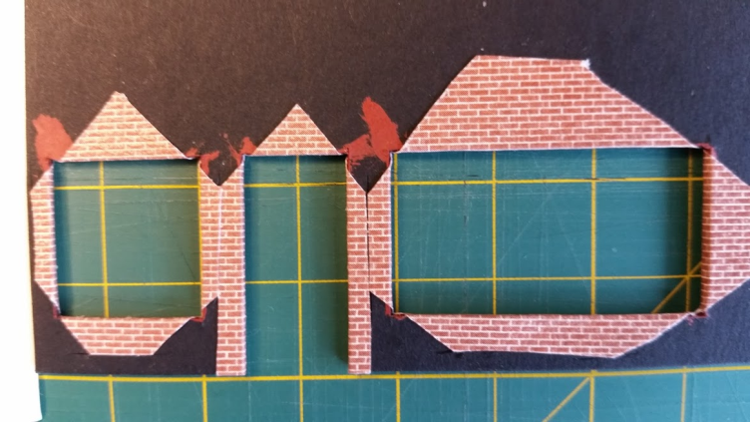
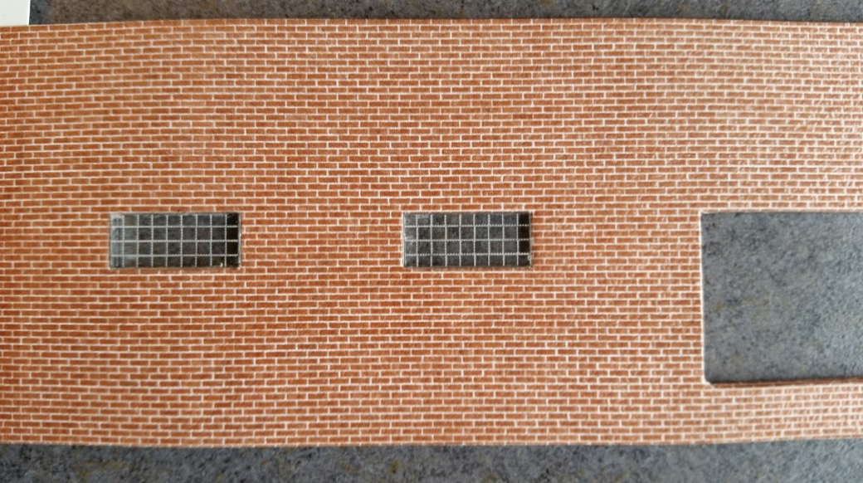
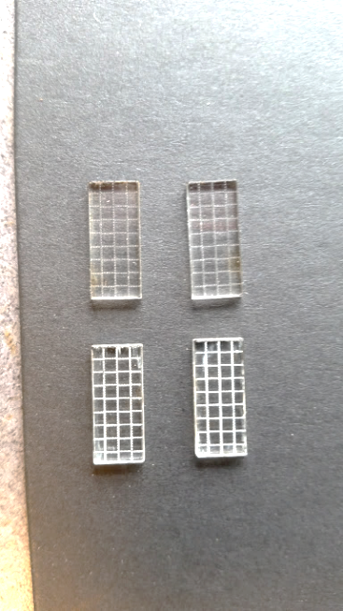
FRONT WALL CONSTRUCTION
A sketch was made of the front wall counting the number of bricks in the original photo for the vertical and horizontal dimensions knowing the size of a prototype brick. Micro-Mark adhesive backed brick paper was used for the outer wall surface. Glass blocks were made by laser etching the mortar lines in 1/8” clear Plexiglas, then laser cutting the window itself. White acrylic paint was brushed on then wiped off to highlight the mortar lines. The photo shows the windows with no paint on top and painted mortar lines below.

Slide 5
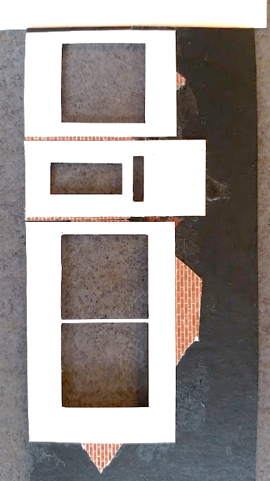
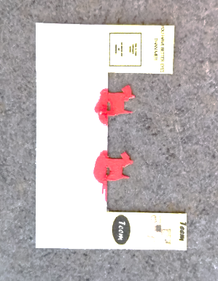
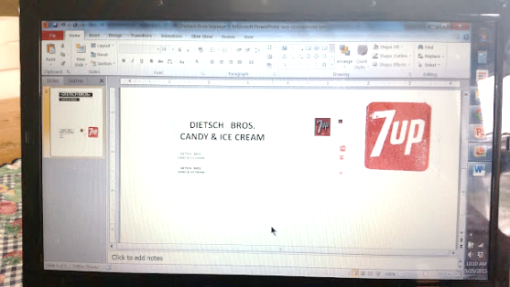
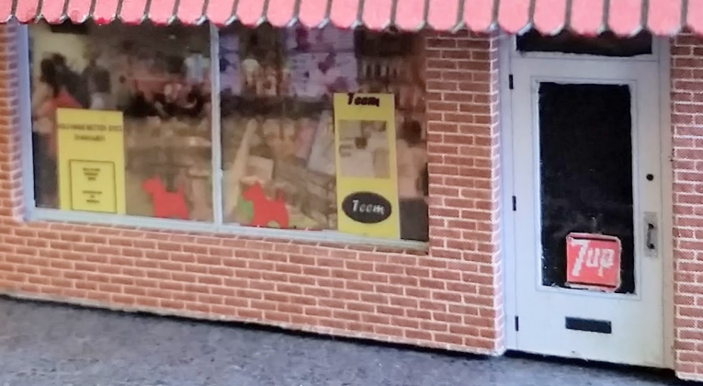
FRONT WALL CONSTRUCTION – Doors & Windows
Doors and windows were drawn using MS-PowerPoint then printed on 60# paper. The window area of each was cut out with a SHARP Exacto knife. Clear styrene was glued behind each. The door’s lower window was covered with a black stocking to simulate screen . The advertisements were cut out and glued behind the double window. Photos(1, 2) of the current actual interior were taken, printed and glued behind the windows to simulate an interior.
Photo taken prior to blackening edges of awning

Slide 6
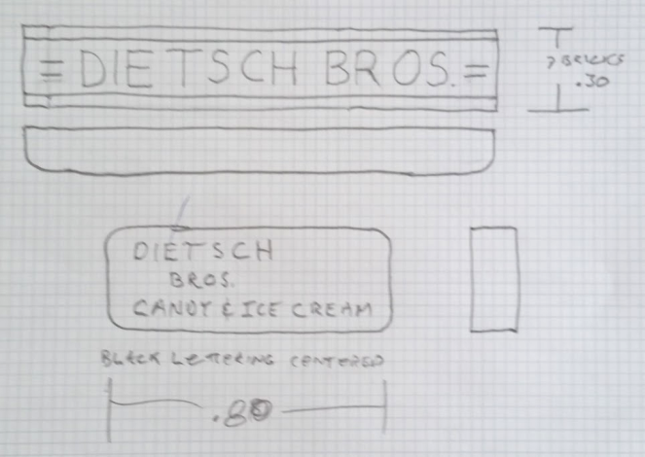
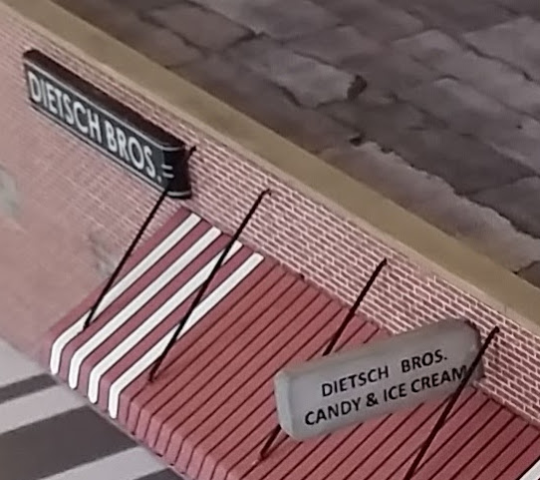
FRONT WALL CONSTRUCTION – Signs
The flat sign was made
with a piece of 1/8” white
styrene. The ends were
sanded and filed for the curve of the
original with the top and bottom edges then painted black. The signage was drawn with MS-PowerPoint, the font with no “fill” on a black background, then printed on clear overhead transparency. A glue stick was used to glue the sign to the base. A heat gun was used to “gently” heat the transparency so it would bend to the small radius of the curved ends. The smaller sign was similarly constructed, only with black font on the clear transparency. The plastic was cut from an 1/8” thick, 80% transparent acrylic sheet.

Slide 7
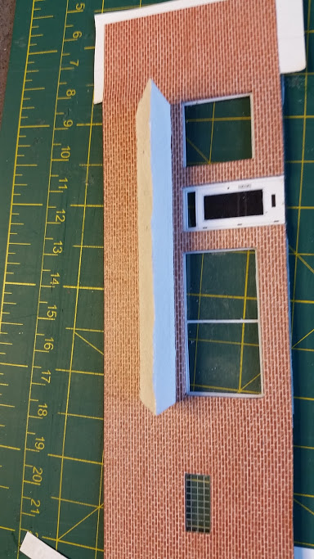
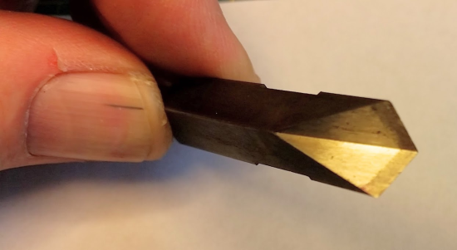
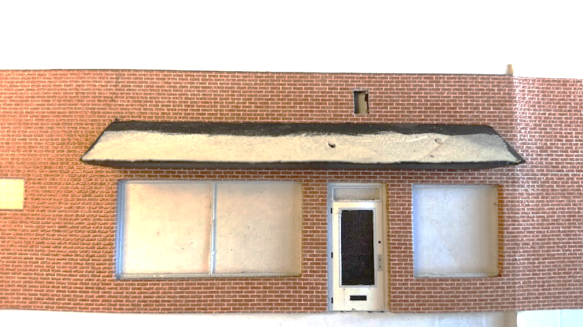
FRONT WALL CONSTRUCTION - AWNING
I designed the awning again using MS-PowerPoint. It was then printed on 60# paper. The scalloped lower edge was cut out using a 90 corner punch sold by Micro-Mark. The edges were “painted” with felt markers. I felt the paper would be too fragile as the finished product, so I cut a substructure from scrap, making it shorter than the awning. I painted the ends and bottom grimy black to help it be less noticeable. The paper was glued to the substructure. Brass rod was formed for the supports.

Slide 8
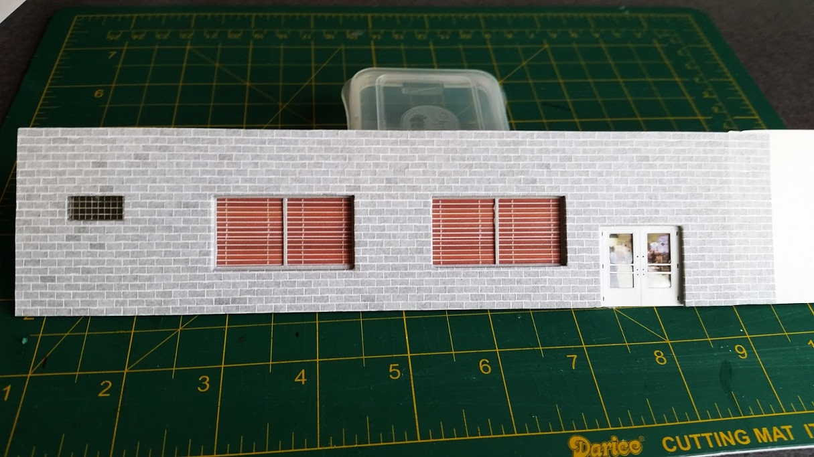
LONG WALL CONSTRUCTION
The side street wall was made in a similar fashion as the front wall. Windows and door openings were cutout of the substructure. This was then covered with Micro-Mark’s adhesive backed cinder block paper. Windows and doors were drawn with MS-PowerPoint, printed on 60# paper, cut out and glued to the back of the wall. Clear styene was glued behind the windows, followed by blinds in the windows and real photos for the doors.
The other long wall has no openings. The front brick carries around each side two bricks wide as it does on the prototype.

Slide 9
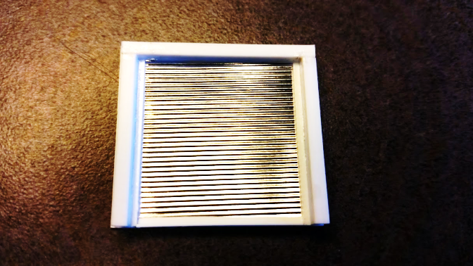
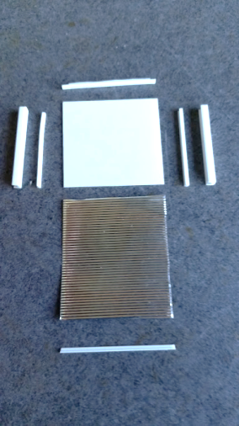
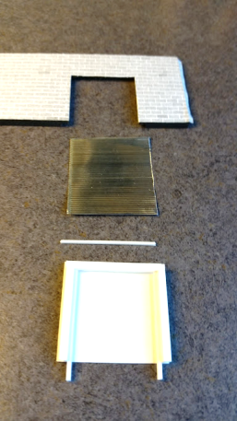
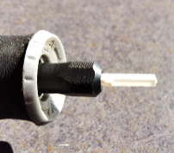
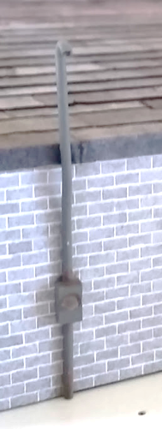
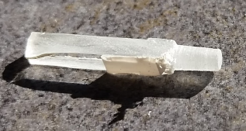
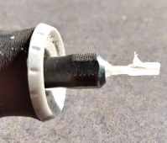
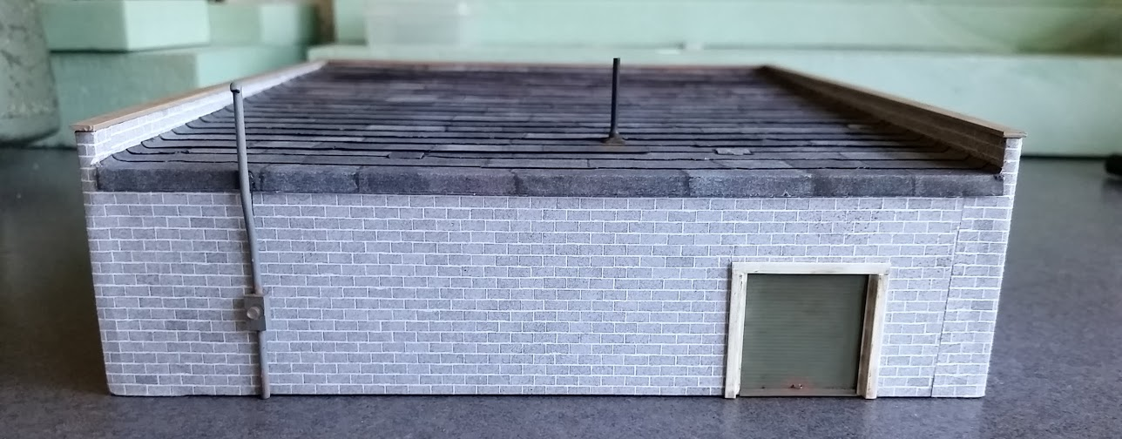
REAR WALL CONSTRUCTION
The 1950’s rear wall layout is unknown so modeling license was employed. I opted to place an overhead door for delivery access. The door was made from styrene shapes with corrugated aluminum for the door itself. .010 music wire was formed for a handle on this door and the side and front doors as well. Light weathering was applied to the finished door.
I fabricated an electric service entrance with styrene shapes. The upper rod was warmed and shaped. A piece of clear flat styrene was turned and used to form the electric meter itself.

Slide 10
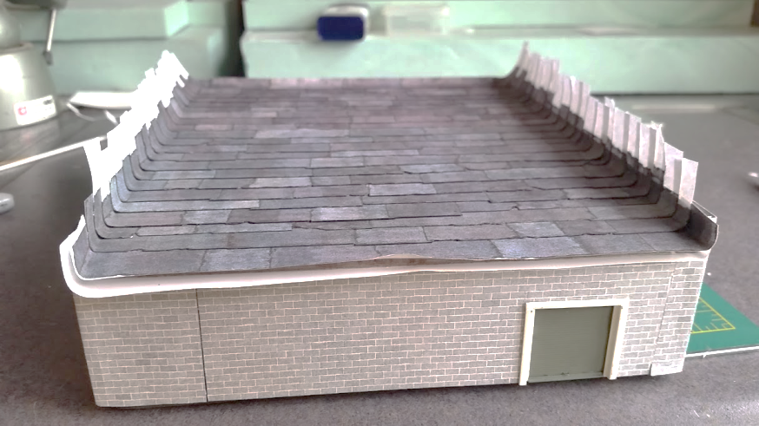
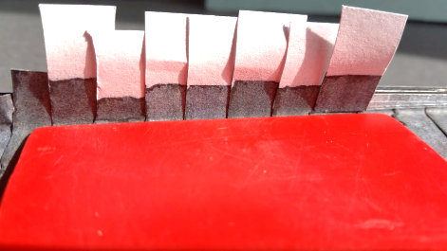
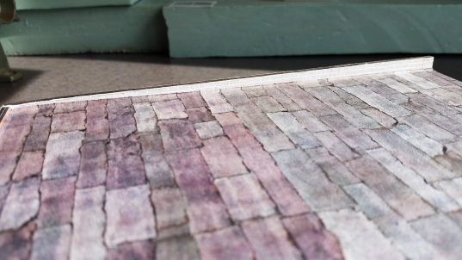
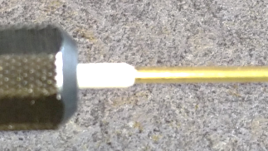
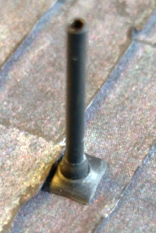
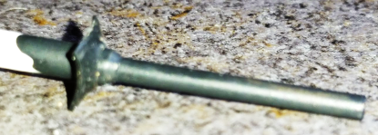
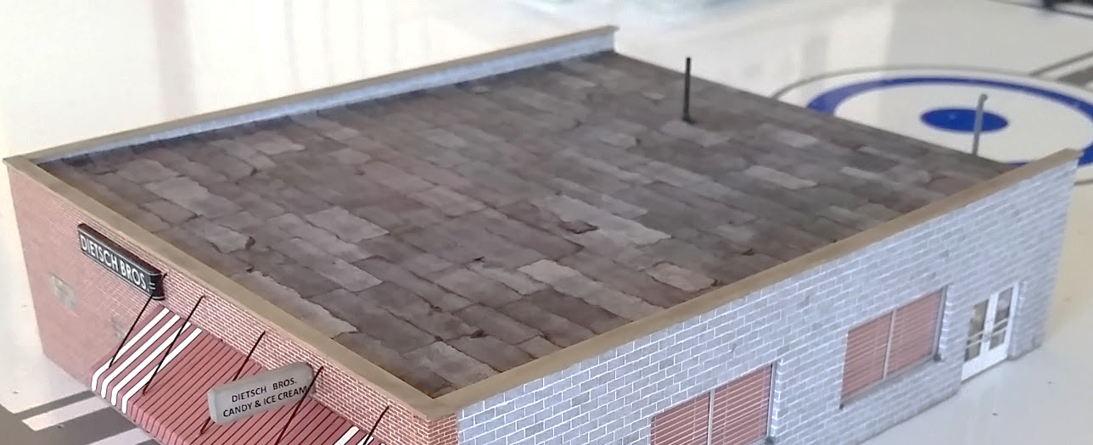
ROOF CONSTRUCTION
1/8” Masonite from an old clip board was used for the roof substructure. A web search provided a photo for tarpaper roofing. Copy paper was cut, edges darkened with a felt pen and applied, overlapping as prototype practice. Prototype roofing material extends up on to sidewalls to provide a weather seal. I simulated this by cutting the paper using a plastic putty knife to give the height needed above the flat roof. The vent stack was made from brass tubing which was drilled out on the end to thin the walls. A piece of styrene tubing was drilled and pushed onto the lower end. A square of shrink tubing was punched with a hole, then slid in place over the styrene to form the boot. Flat styrene was scribed for joints and applied to the top of the walls for simulated stone or concrete caps. Light weathering was applied.

Slide 11
TOOLS & MATERIALS USED
MS-PowerPoint, or similar software, is a highly useful
modeling tool.
CAD is better with lines and other vector based objects and can be used as an alternative but does not manipulate graphics as well
Google Earth can be your friend
County auditor websites can provide a wealth of information
The Micro-Mark Aged Factory Brick Paper, Item # 84730 and Cinder Block Paper, Item # 83105 is great, BUT…
It is usually best to construct structure walls while in the flat. The front wall brick paper needed to extend around and onto each sidewall so I left it long during construction of the front wall itself. The wall required extensive handling during construction which caused the paper to have a crease I could not totally remove when assembling the walls. Unfortunately too late to redo.
Buy No. 11 knife blades, Micro-Mark Item # 14178
in quantities of 100…or more!
Micro-Mark 3/16 corner punch, Item # 82394 or 5/16 Item # 81652
Taking photos during construction allows you to “see” items needing improvement
Example – awning edge needing to be darkened

Slide 12
LESSONS LEARNED
Look for DEFINING items during the design phase
Spray items printed on 60# paper with dullcote for durability and to reduce fuzz
Dark women’s stocking does NOT make effective door screen
In PowerPoint, cut then “paste as a picture” items made of multiple objects when resizing
Eliminates issues with resized text not fitting original boundaries and multiple lines not staying connected
More care or better process required to cut the window and door openings in the substructure square from front to back
There is a reason for SELECTIVE COMPRESSION
Don’t settle for less!
I made two flat signs to get one acceptable
I made FOUR awnings before accepting the final version
I SHOULD HAVE made a new front wall substructure

Slide 13
QUESTIONS??

